Slide 1
Simple Tutorial for VASP
Guozhen Zhang, Xijun Wang
(guozhen@ustc.edu.cn)
2016.11.24

Slide 2
What VASP can offer?
structure( via optimization) and energy
electronic and magnetic structures
(partial, local) density of states
bands structure
charge distributions (STM simulation)
work function
magnetism structures
ab initio molecular dynamics
vibrational frequency (IR)
reaction paths
core level shift (CLS)
Berry Phase, optic properties, etc
Notes:
CLS – X-ray photoelectron spectroscopy spectra of surface atoms

Slide 3
Computational Setup
Periodic boundary condition , supercell
Plane wave basis sets (ENCUT, ENAUG)
K-points sampling (Automatic, or manual)
Pseudo Potential: UltraSoft PP and PAW
LDA, GGA, hybrid functional
PW91, PBE, RPBE
PBE0, HSE06…
other strategy
L(S)DA+U
vdW-DF functional
GW method
……

Slide 4
How to Start a VASP Calculation?
An pre-compiled executable file of VASP
Four input files
INCAR: control parameters
POSCAR: lattice constant and coordinates of atoms
KPOINTS: k-points sampling
POTCAR: chosen pseudopotential
How to prepare input files?

Slide 5
Basic Idea of SCF Calculation in VASP

Slide 6
The INCAR File
Electronic Part
SCF
Geometric Part
Optimization/single point calculation
Rest
VDW correction
DOS calculation output control
Print control (charge and wavefunction)
parallelization
Keyword list and the details are available in the VASP manual.

Slide 7
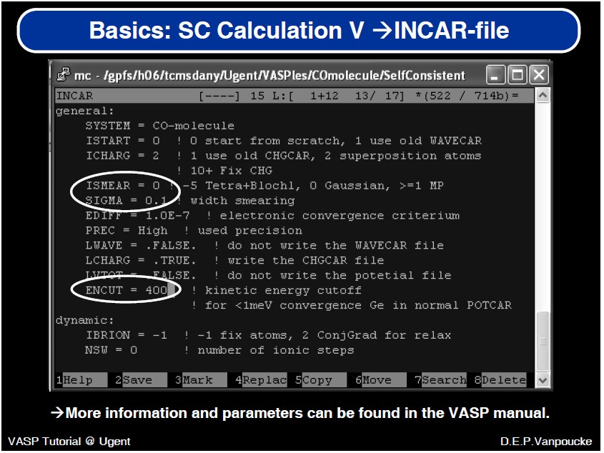

Slide 8
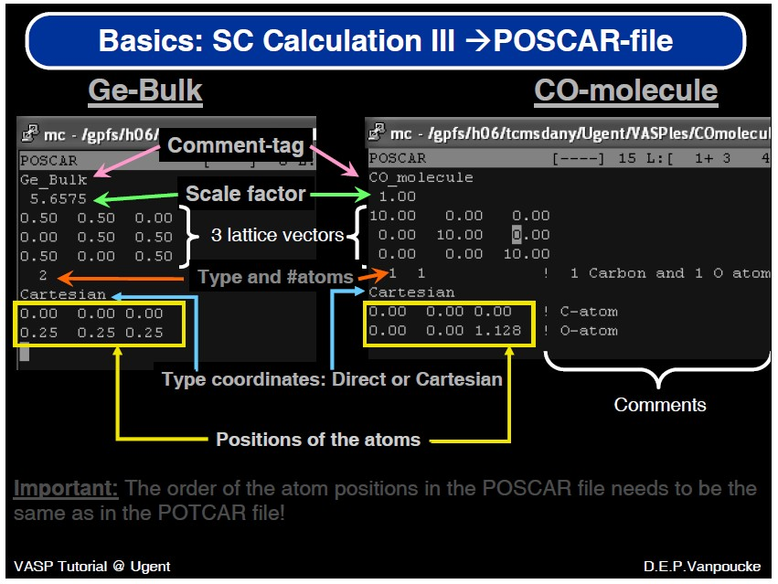

Slide 9
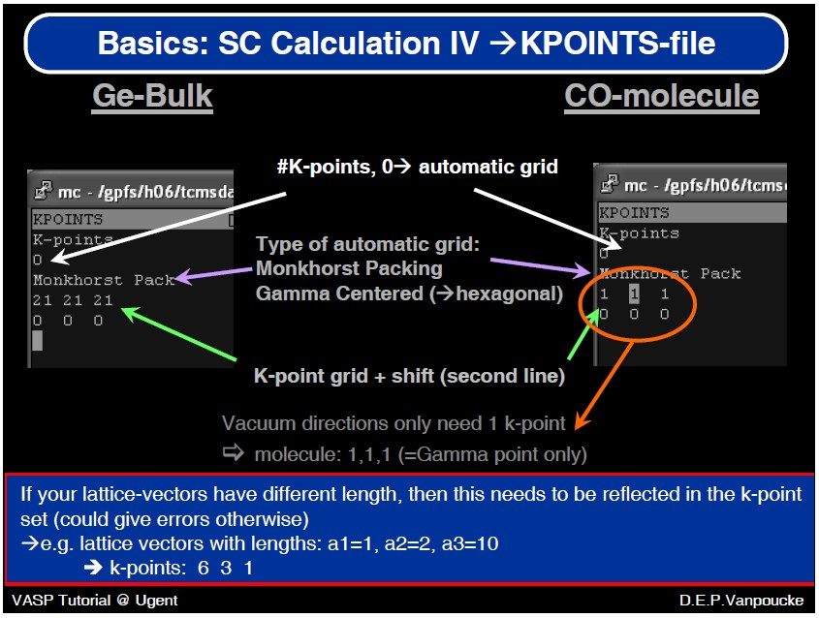

Slide 10
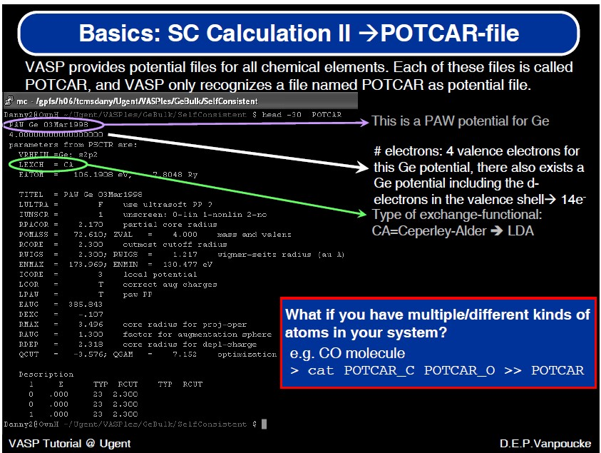

Slide 11
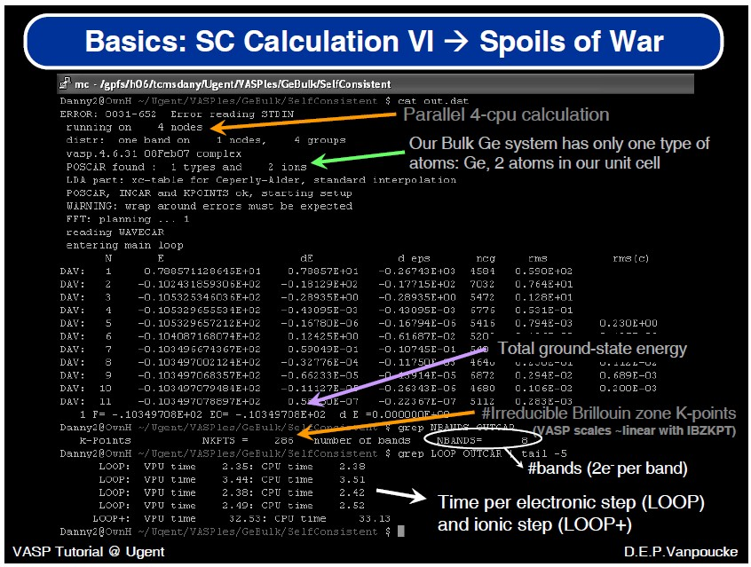

Slide 12
Are Our Results Physically Meaningful?

Slide 13
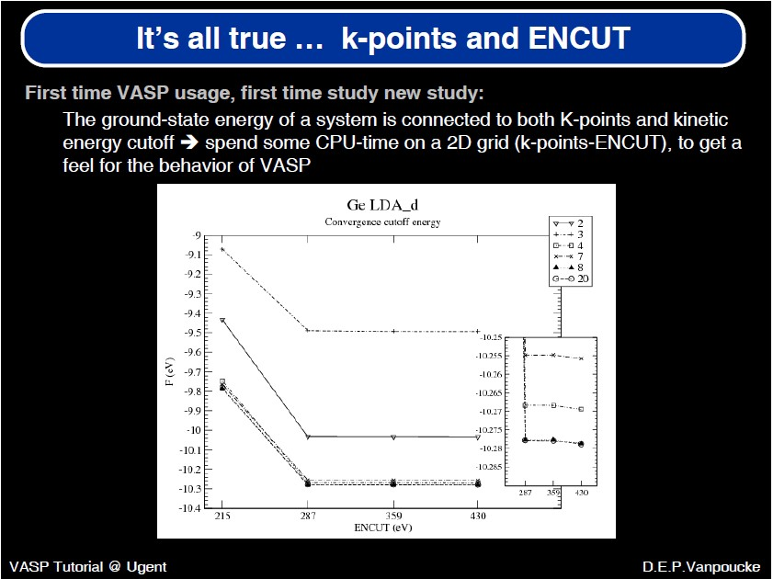

Slide 14
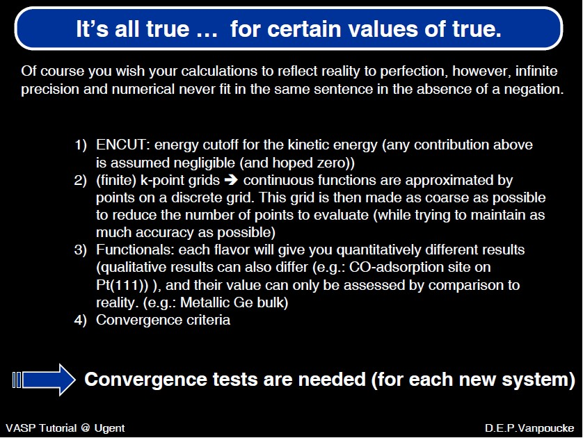

Slide 15
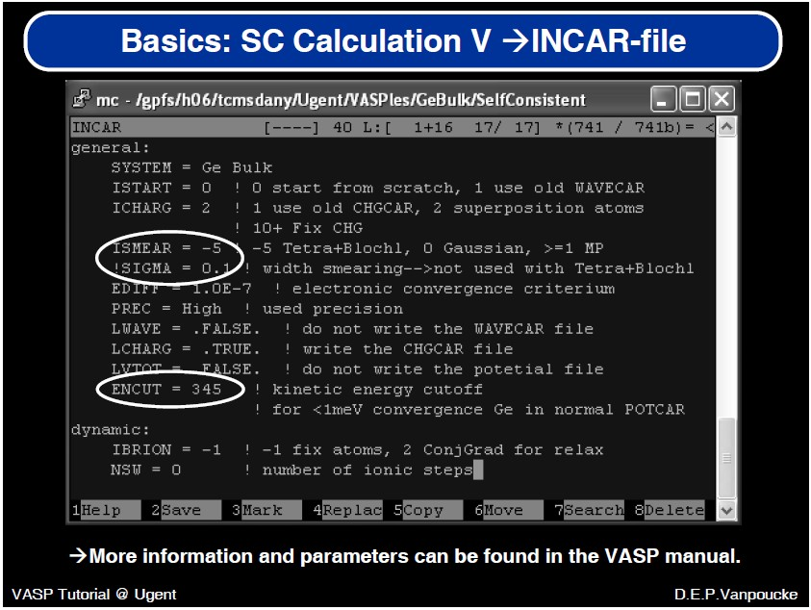

Slide 16
How to Get a Valid Geometric Structure?
geometric optimization of lattice constants

Slide 17
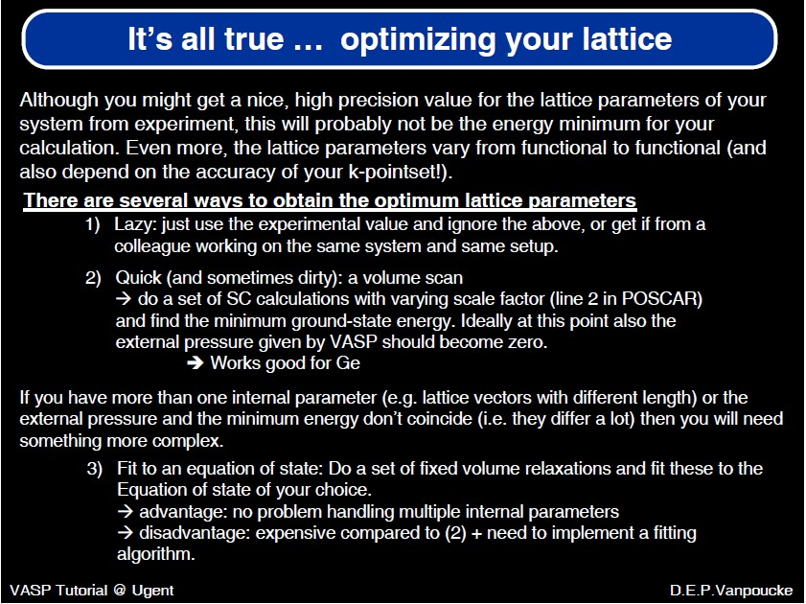

Slide 18
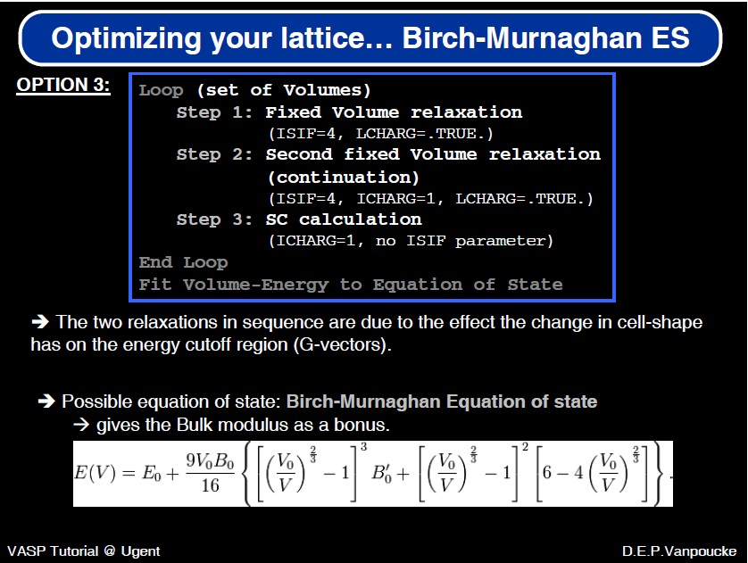

Slide 19
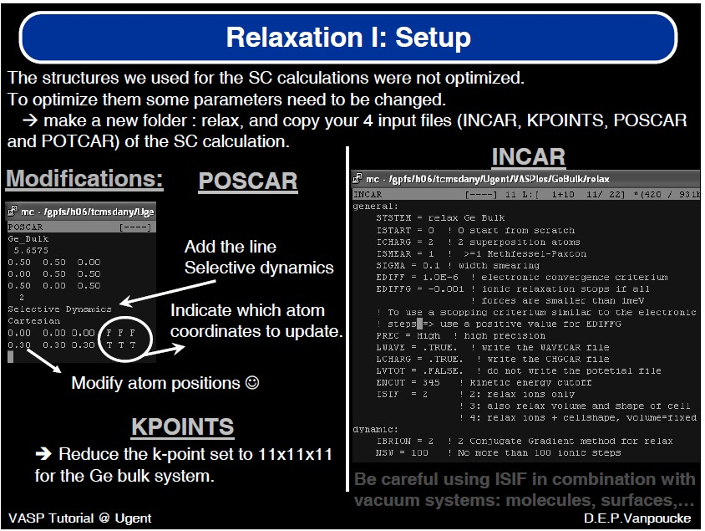

Slide 20
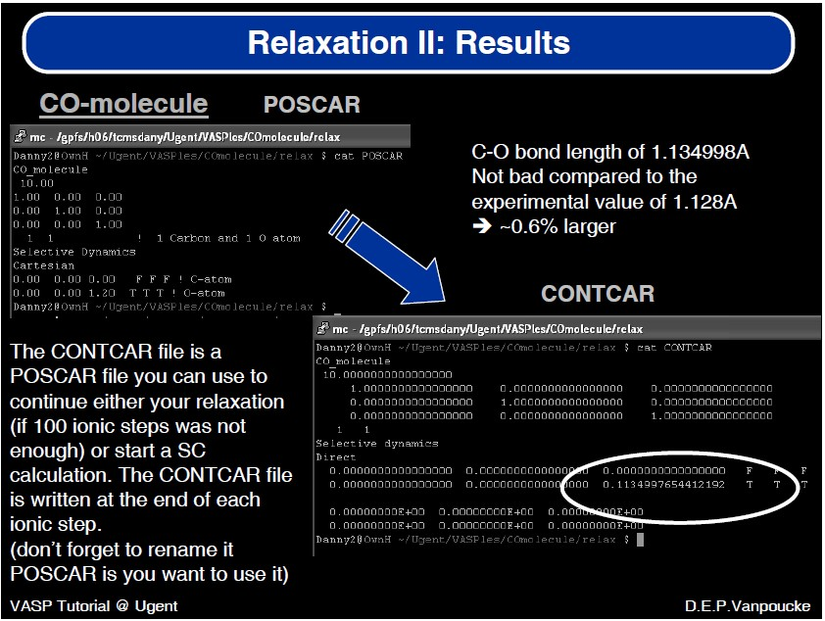

Slide 21
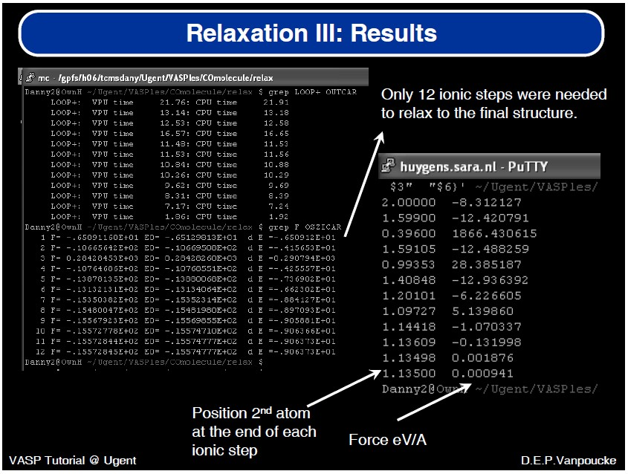

Slide 22
Important parameters
Accuracy: Medium, Accurate, High…
ENCUT: ***eV
ISPIN: =1 or 2 (closed shell or open shell)
ISMEAR: 0, 1, 2, -5….
SIGMA
IRION = -1, 0, 1, 2, 5, 6 ….
ISIF = 2, 3, 4….
ISYM = 0, 1, 2…
VOSKOWN = 1
EDIFF, EDIFFG,
NSW step
GGA = PW | PB | LM | 91 | PE | RP | PS | AM

Slide 23
Advanced Properties
band structure
(partial, local) density of states
charge distribution (STM…)

Slide 24
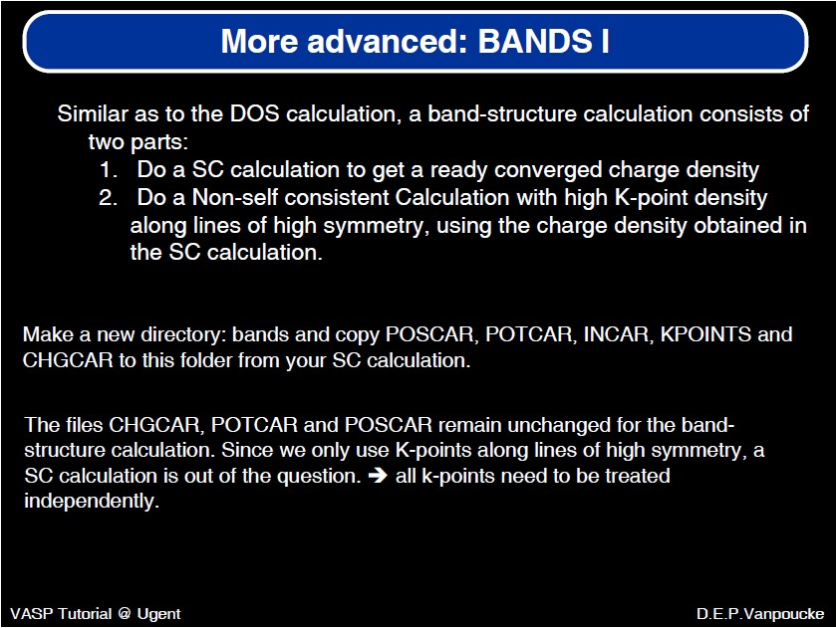

Slide 25
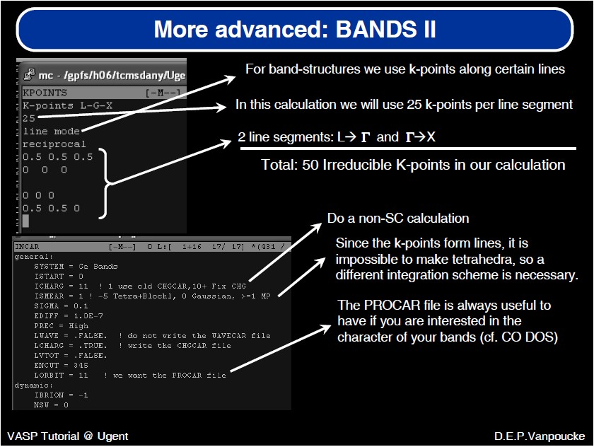

Slide 26
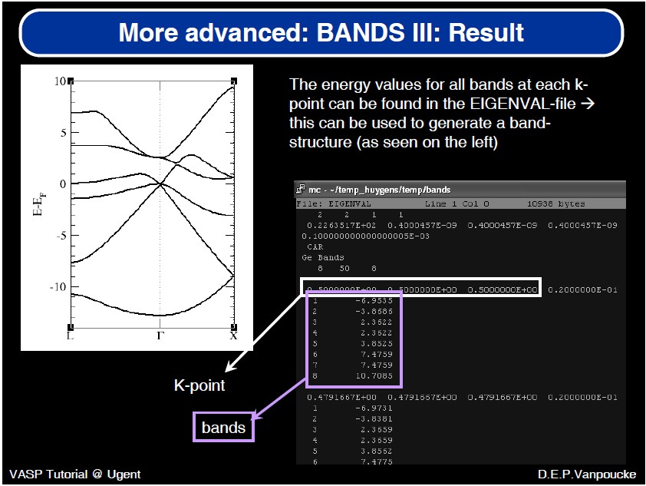

Slide 27
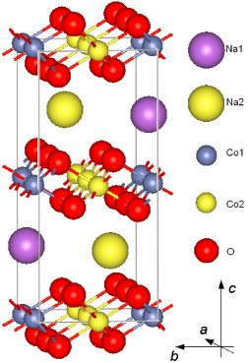
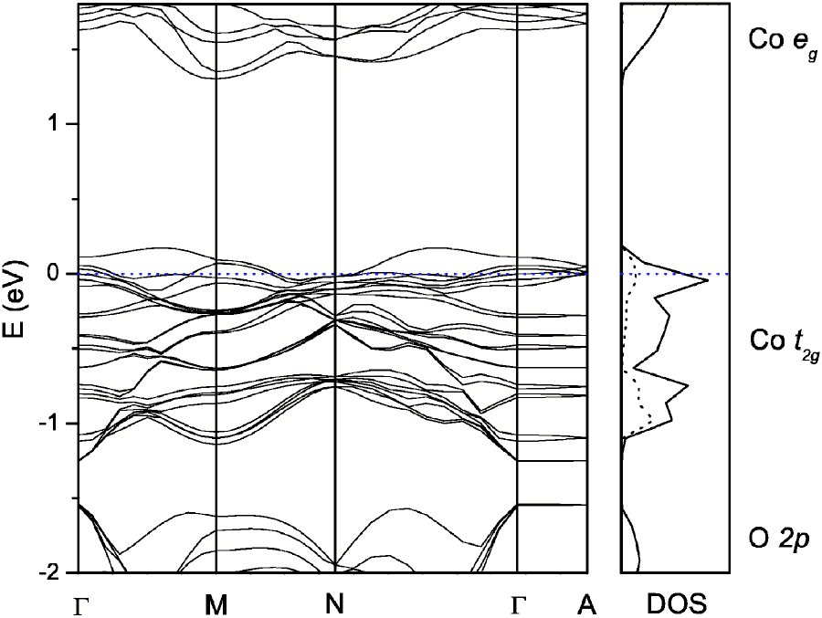
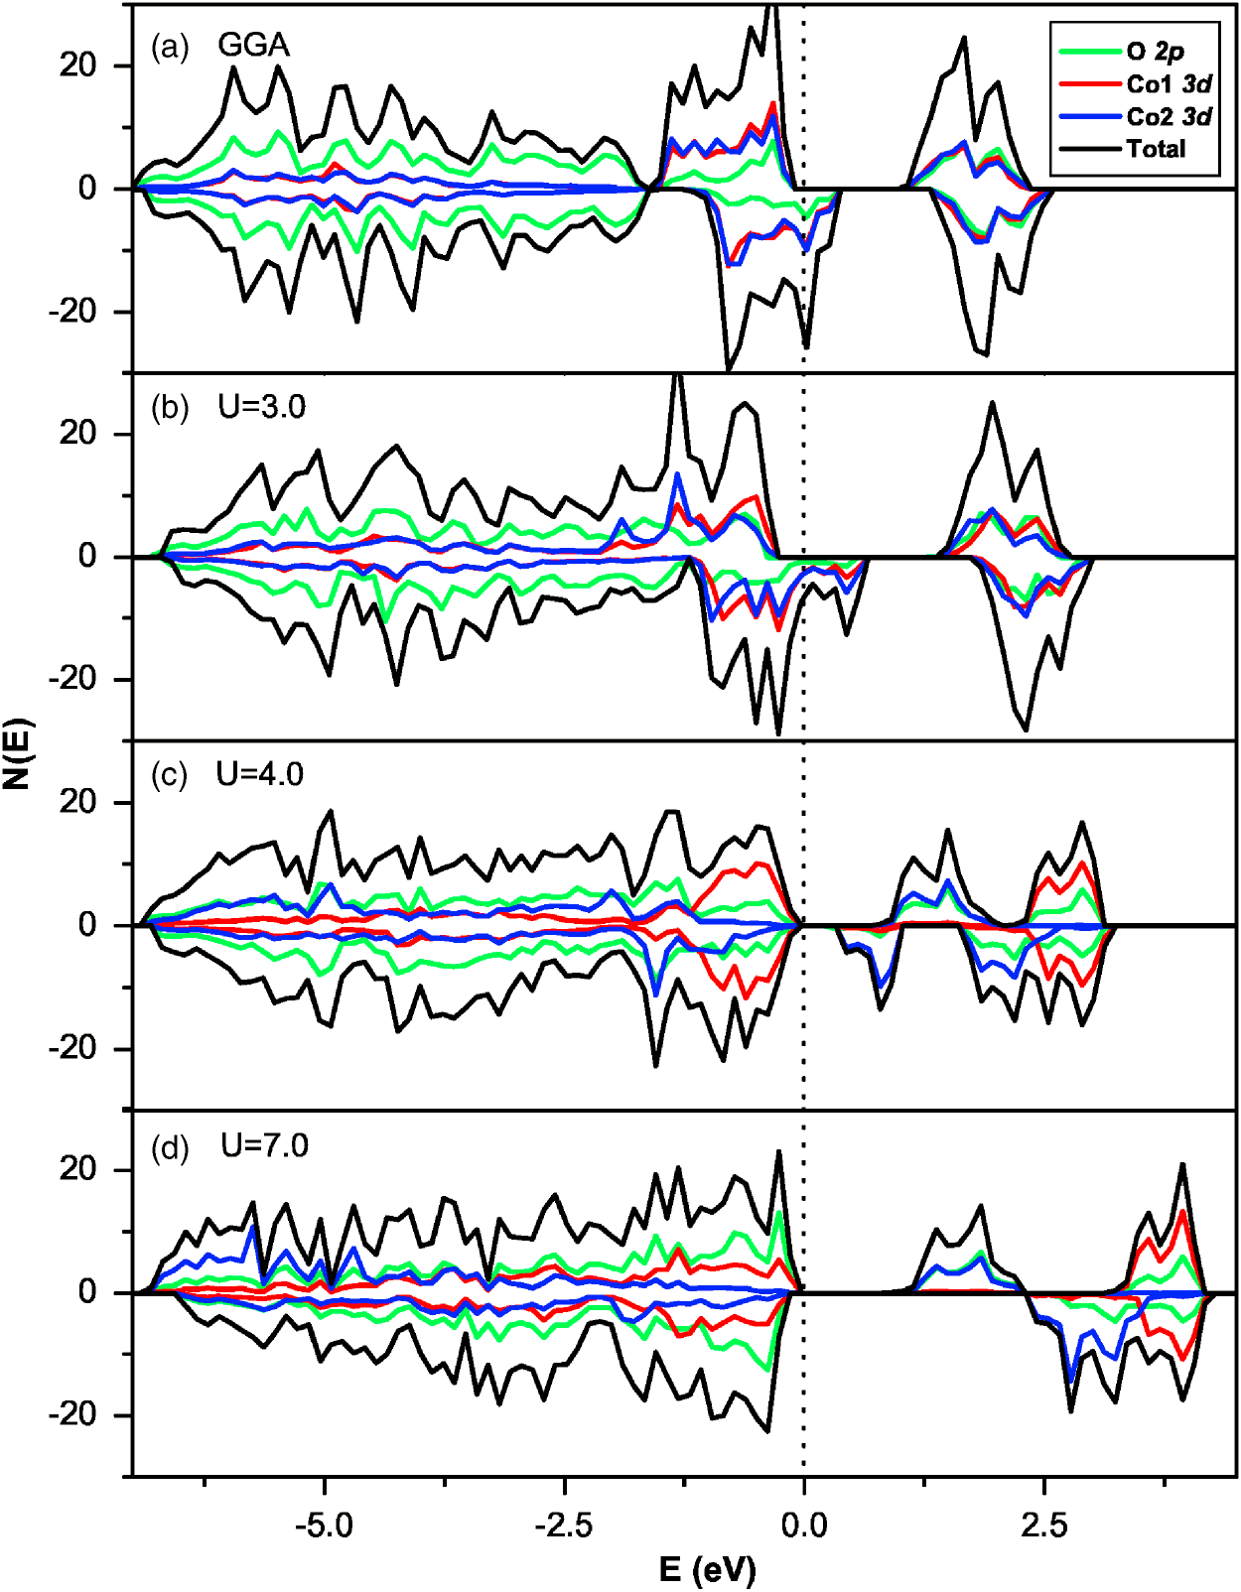
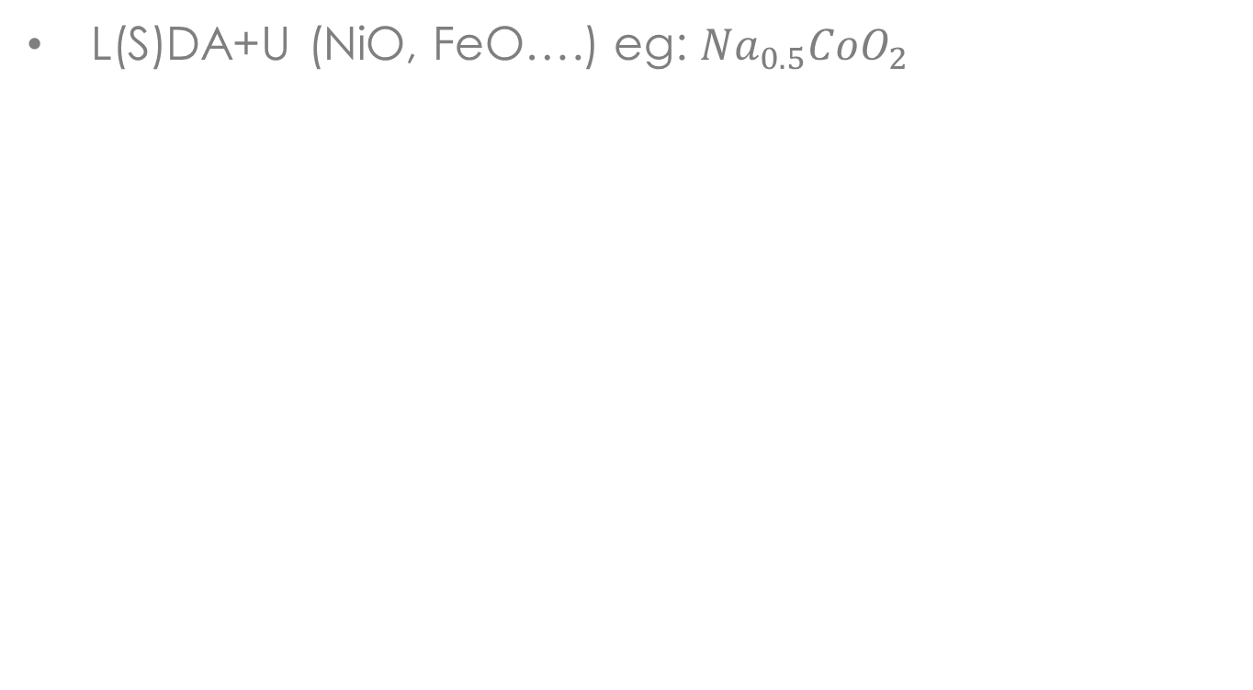
Band Gap (I)
L(S)DA+U (NiO, FeO….) eg: ${Na}_{0.5}{CoO}_{2}$
LDAU = .TRUE.
LDAUTYPE = 1 # Dudarev's
LDAUL =-1 -1 -1 2 -1
LDAUU = 0 0 0 2.7 0
LDAUJ = 0 0 0 1.0 0
PRB 71, 024502 (2005)

Slide 28

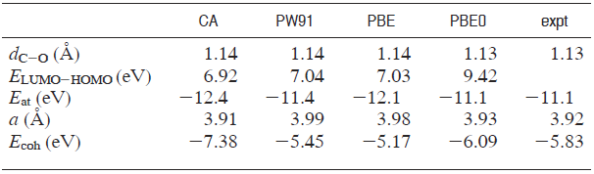
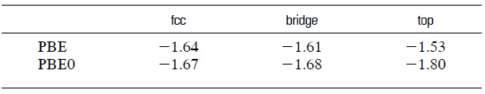
Band Gap (II)
PBE0 (CO) GGA= PBE0
# Exchange and Correlation functionals
AEXX =0.25
AGGAX =0.75
AGGAC =1.0
ALDAC =1.0
ENCUTFOCK= 0
LMAXFOCK = 4
NKRED = 2
TIME = 0.4
LHFCALC =.TRUE.
JACS 129, 10402(2007)

Slide 29
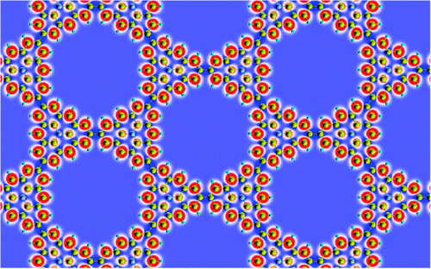
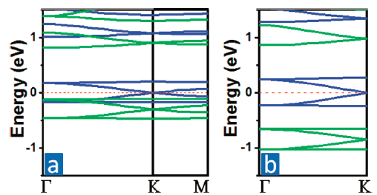
HSE06 (semiconductor)
# Exchange correlation treatment:
LHFCALC = .TRUE.
HFSCREEN = 0.2
AEXX = 0.25
AGGAX = 0.75
ALDAC = 1.0
AGGAc = 1.0
ENCUTFOCK= 0
LMAXFOCK= 4
NKRED = 2
TIME = 0.4
JACS (2012)

Slide 30
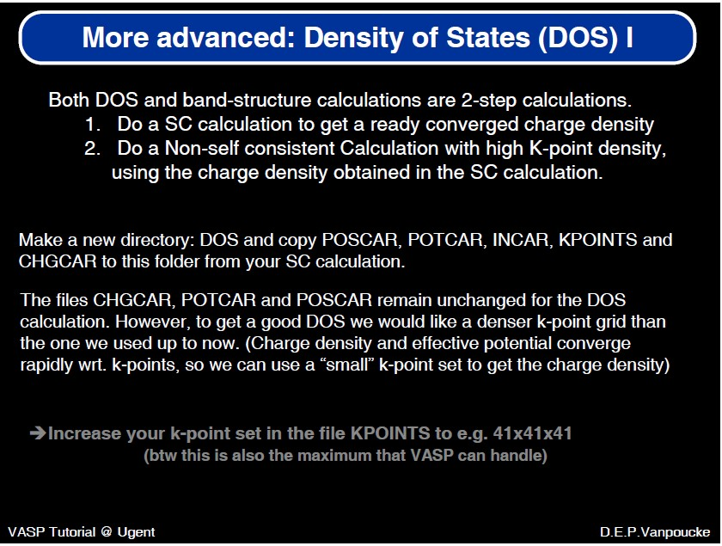

Slide 31
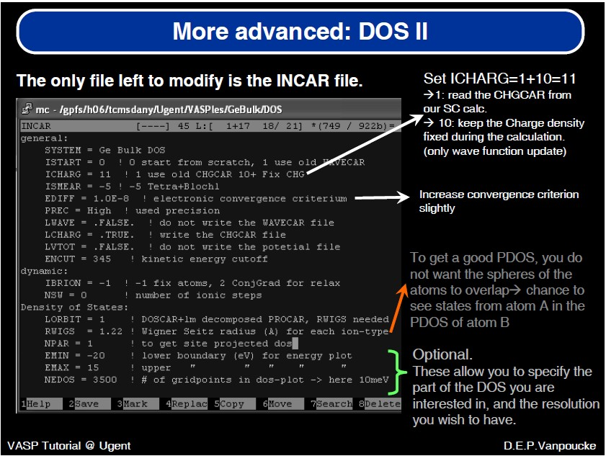

Slide 32
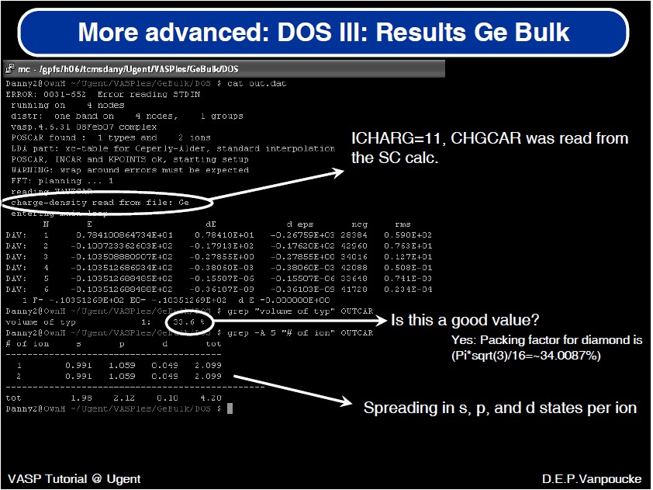

Slide 33
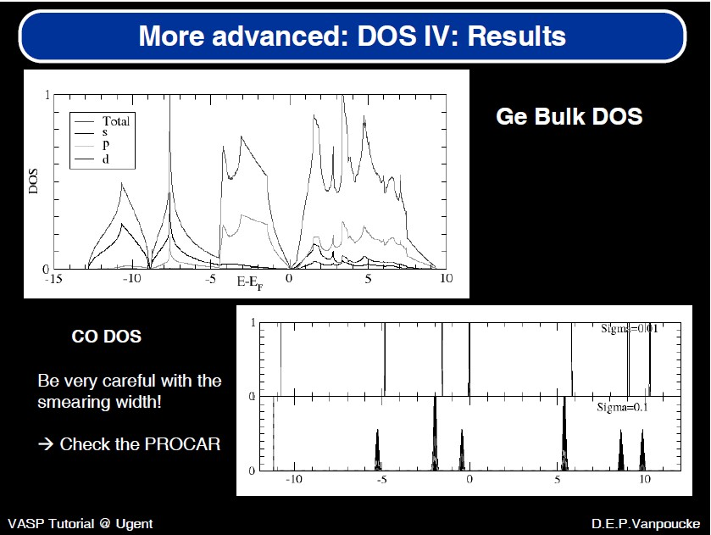

Slide 34
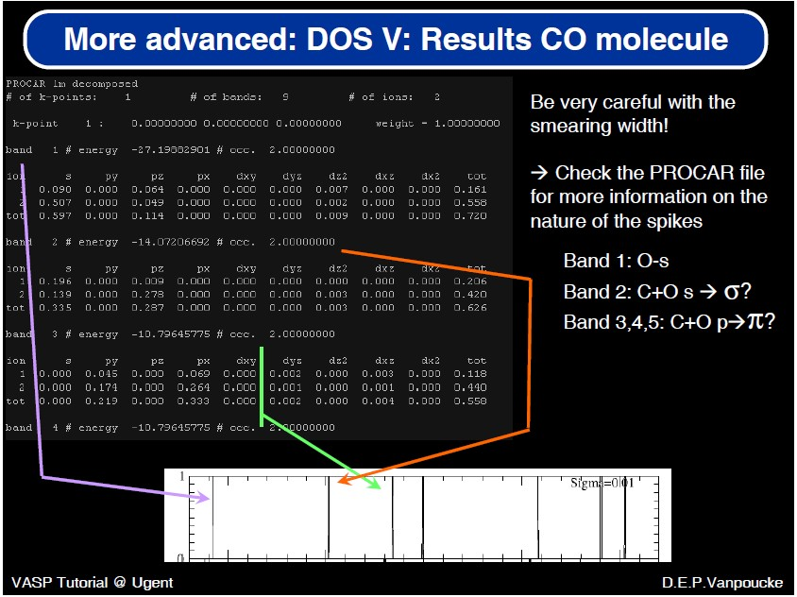
Analysis of molecular orbital

Slide 35
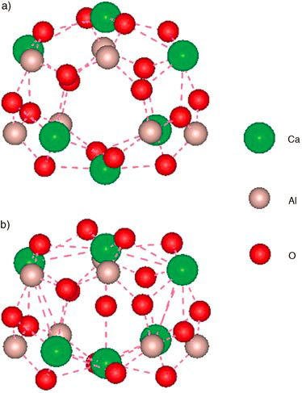
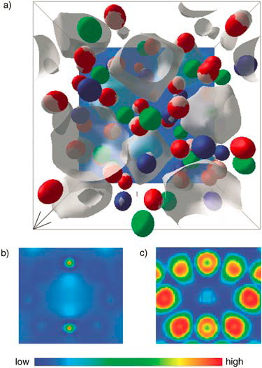
Electron Localization Function
C12A7 mayenit
LELF = .TRUE. | .FALSE.
ELFCAR
Nature 371 (1994) 683-686
Angew. Chem. Int. Ed. 43, 6479 (2004)

Slide 36
Surface System
periodic among x-y plane while not along z
surface geometric (reconstruction)structure
electronic and magnetic structure
chemical processes on surface
interface of solid-solid, solid-gas and solid-liquid
simulation of spectroscopy, such as STM, IR, XPS etc

Slide 37
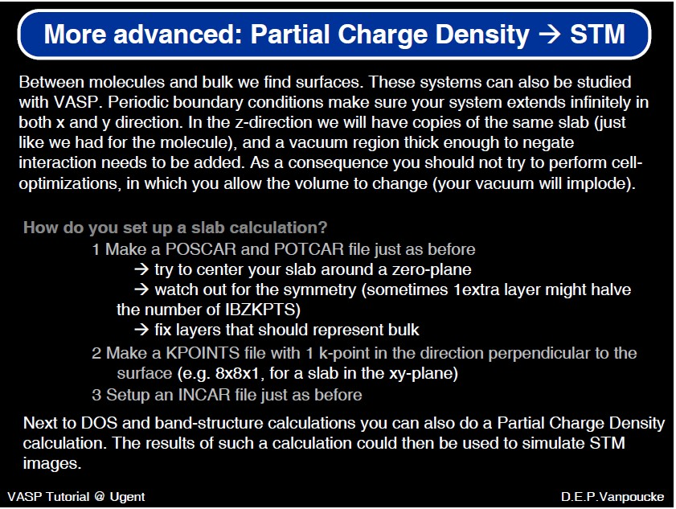

Slide 38
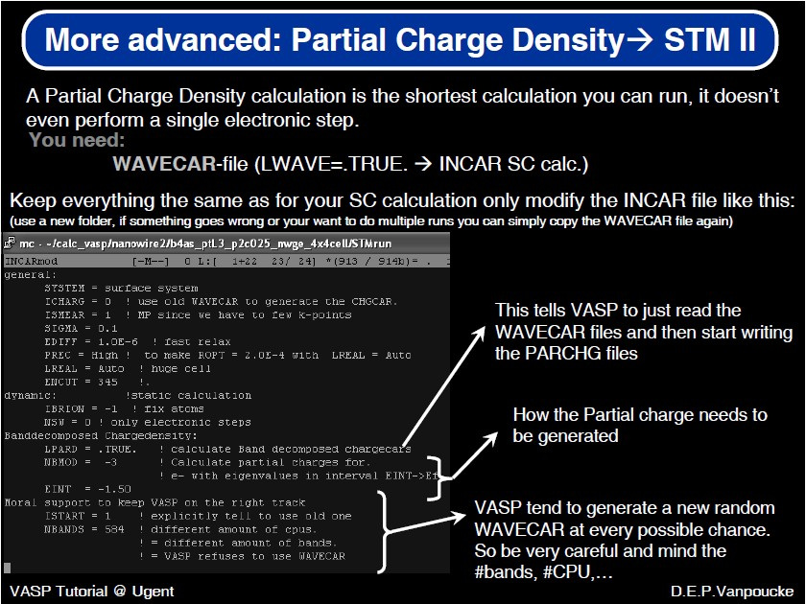

Slide 39
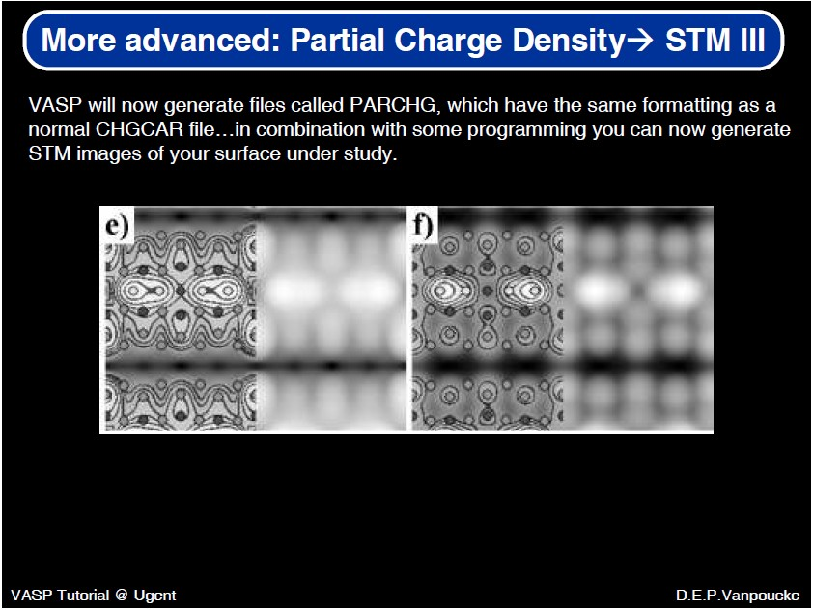

Slide 40
Band Decomposition
LDIPOL = .TRUE.
IDIPOL = 1, 2, 3, 4
LPARD = .TRUE.
IBAND = 20 21 22 23 partial charge density for bands
EINT = E1, E2, if only one relative to Ef
NBMODE = >0, 0, 1, -1, -2, -3 (manual)
KPUSE = 1, 2, 3 , 4 k-points used
LSEPB = .TRUE. (PARCHG. nb,.* will be written)
LSEPK = .TRUE. (PARCHG.*.nk will be written)
LVTOT = .TRUE. (LOCPOT will be written, work function)
MAGMOM, NUPDOWN, NELECT

Slide 41
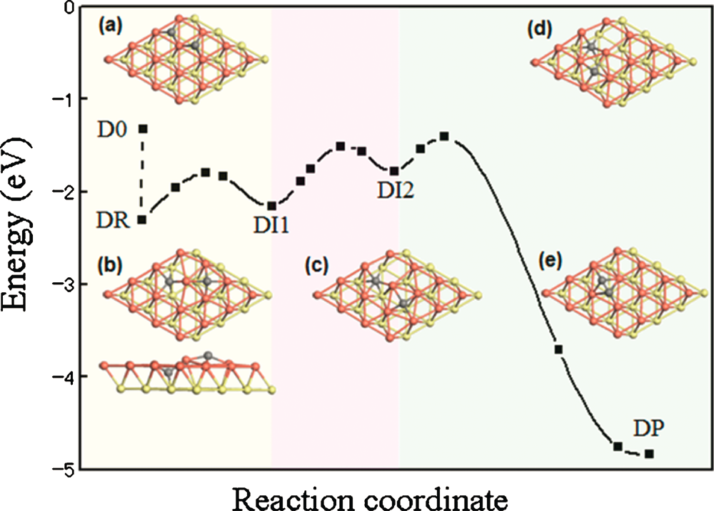
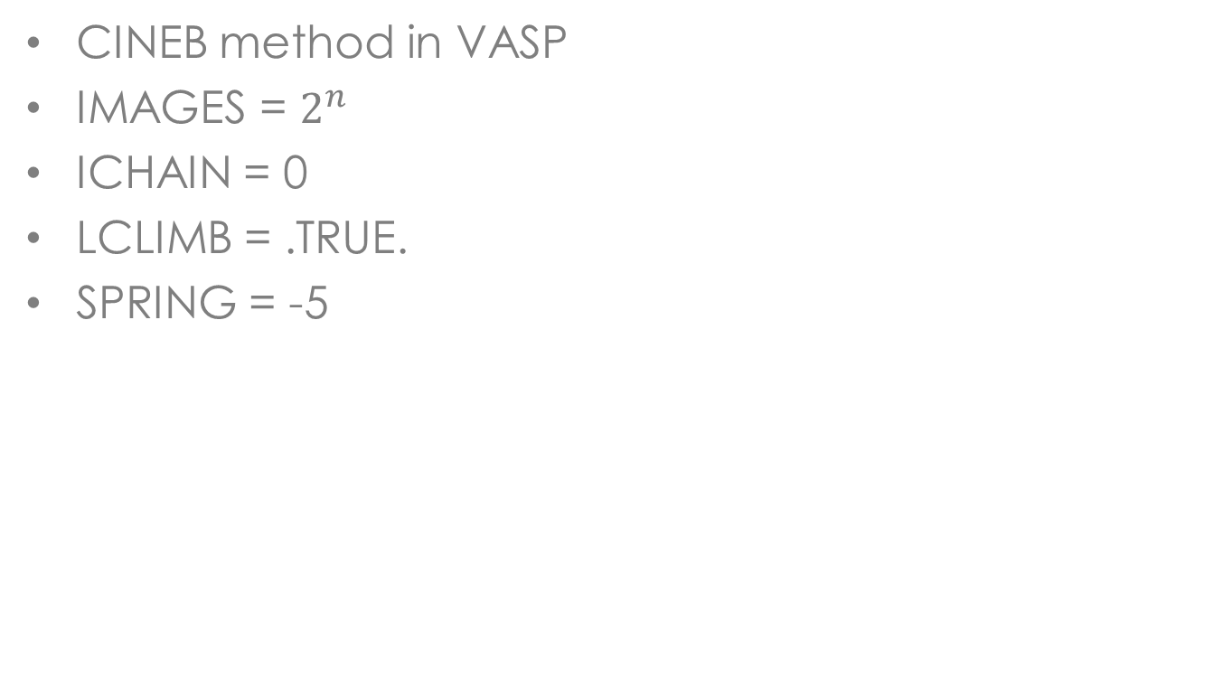
Chemical Processes
CINEB method in VASP
IMAGES = $2^{n}$
ICHAIN = 0
LCLIMB = .TRUE.
SPRING = -5
J. Chem. Phys. 133, 071101 (2010)

Slide 42
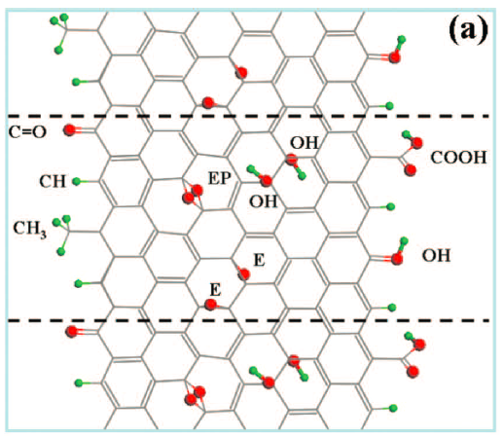
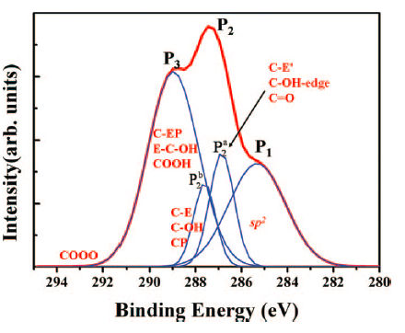
Core Level Shift (CLS)
Icorelevel = 0 / 1 /2 (approx final/ initial /acc. final state)
CLNT = 1,2,3,... according to POSCAR
CLN = 1,2,3... N quantum number
CLL = 1,2,3 (l QN)
CLZ = 1 (number of electrons removed from core)
NELCT = the number of valence electrons
Z+1 approximation
J. Chem. Phys. 131, 244505 (2009)

Slide 43
Vibrational Frequencies
IBRION = 5
POTIM = 0.02

Slide 44
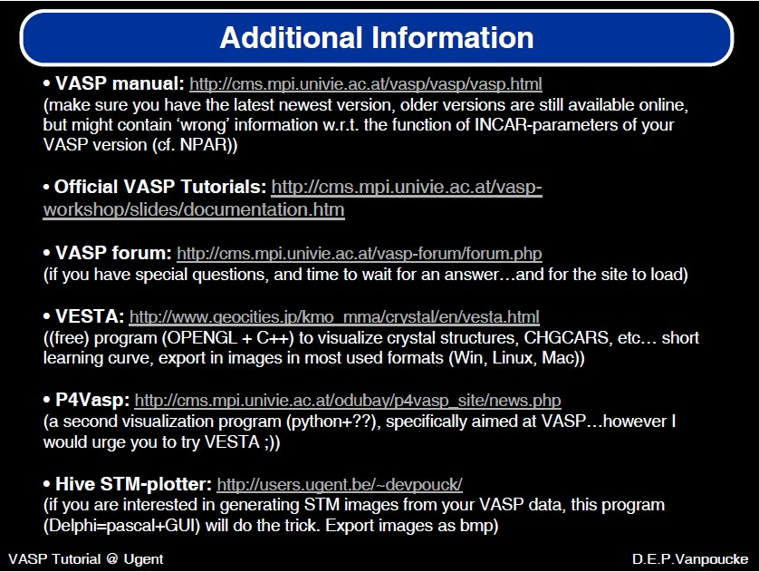

Slide 45
Thank you for your attention!

